Slide 1
Lecture 22 October 25, 2019
Great job in lab. As flies emerge from cv, y, f vials we are sorting females and putting them in the most healthy looking vials of wt. males. It’s likely not everyone will have a P XP vial of their own, but when F1 flies emerge, there will be enough for all. More cv, y, f vials will start producing next week, so the F1 flies will emerge from different vials over about 10 days…

Slide 2
Next week. Lab 5/7 due Thursday, Oct. 31st. Lab quiz 2 also on Thursday, Oct. 31st. (Guidelines Monday)
Guidelines for lab 5/7 today.
Looking ahead. I will be out of town, Nov. 25th.
I am moving Exam 3 from Nov. 18th to Nov. 22. (That means no Genetics lecture or lab all of Thanksgiving week).

Slide 3
Where were we?....
More 2-gene traits
Dominant epistasis
Purple pigment in sweetpea flowers
Thinking of molecular explanations for modified dihybrid ratios.
Quantitative traits

Slide 4
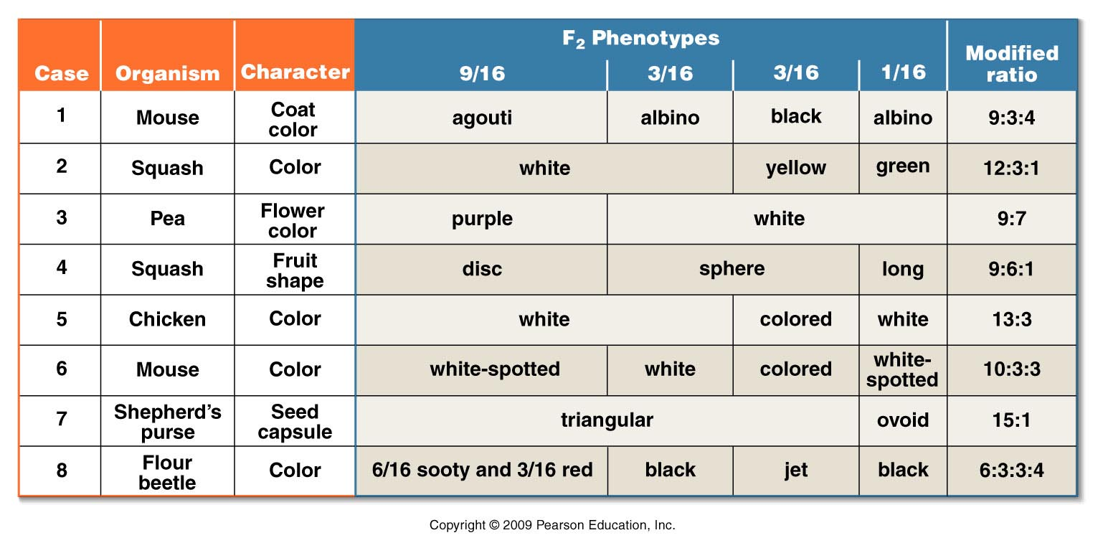
Examples of other modified dihybrid ratios (2 gene traits)
Try coming up with “molecular explanations” for some of these modified dyhibrid ratios! (Make a dihybrid Punnet square)
Figure 4.8
Notes:
Figure 4-8 The basis of modified dihybrid F² phenotypic ratios, resulting from crosses between doubly heterozygous F¹ individuals. The four groupings of the F² genotypes shown in Figure 4–7 and across the top of this figure are combined in various ways to produce these ratios.

Slide 5
These traits show a wide variation of forms or continuous variation.
Most humans---~4 ft. 10 inches—6 ft. 8 inches
Skin color in offspring of the same parents with different skin color varies considerably. https://www.cnn.com/2017/01/24/health/biracial-twins-illinois-trnd/index.html
Red grain color (text example) varies from deep red to white.

Slide 6
Quantitative traits are controlled by several genes (and most of the time, also, environmental factors). Each gene involved contributes a specific increment of the same type to the phenotype. (so many inches, a degree of shade of color).
For each gene 2 types of alleles exist.
Additive (add a specific measurable increment to the phenotype)
Non-additive (add nothing to the phenotype)
Example---Genotype AAbbCcdd (3 additive alleles)

Slide 7
In our previous examples of 2-gene traits, the trait was the result of 2-genes, but those genes encoded 2 uniquely functioning proteins.
For example—ABO blood type:
I-gene encodes a protein that controls whether A or B antigen is produced.
Fut 1 gene encodes the h substance (protein for A or B antigen to be attached)
TOGETHER---the proteins create the blood type phenotype

Slide 8
“Redness” in grain
Let’s try an example---using 2 genes, but the 2 genes encode similarly functioning proteins.
In our example the proteins add a degree of red pigmentation to wheat.
We assume independent assortment of the 2 genes during meiosis.

Slide 9
We’ve seen this before…(said Frodo)
Recall the example of incomplete/partial dominance in snapdragon flowers? When one gene controls the trait, and incomplete dominance is in operation we saw how different “doses” of a gene product affected the organism.
C^{R}C^{R} –2 doses of a red pigment gene product
C^{R}C^{W} 1 dose of red pigment
C^{W}C^{W} 0 doses of red pigment

Slide 10
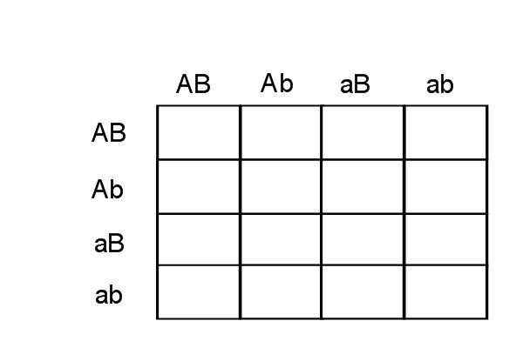
2 genes A and B controd a trait. AaBb X AaBb—fill in the Punnett square and note the frequency of specific genotypes and how many additive alleles they would have

Slide 11
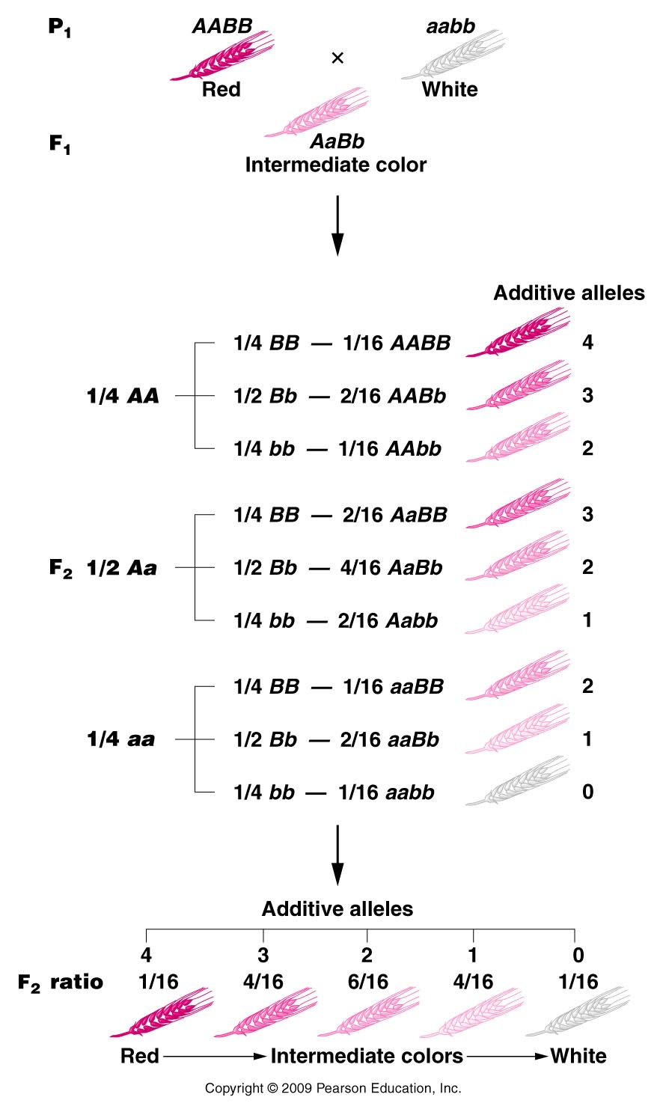
Consider a trait controlled by 2 genes---Quantitative trait.
How many different genotypes---count the additive alleles.
Max= 4 additive alleles
Min =0 additive alleles
3,2,1 additive alleles possible.
What does this intermediate form remind you of ?
Here we see several “intermediate” forms of red.
Figure 25.2
Notes:
Figure 25-2 How the multiple-factor hypothesis counts for the 1:4:6:4:1 phenotypic ratio of grain color when all alleles designated by an uppercase letter are additive and contribute an equal amount of pigment to the phenotype.

Slide 12
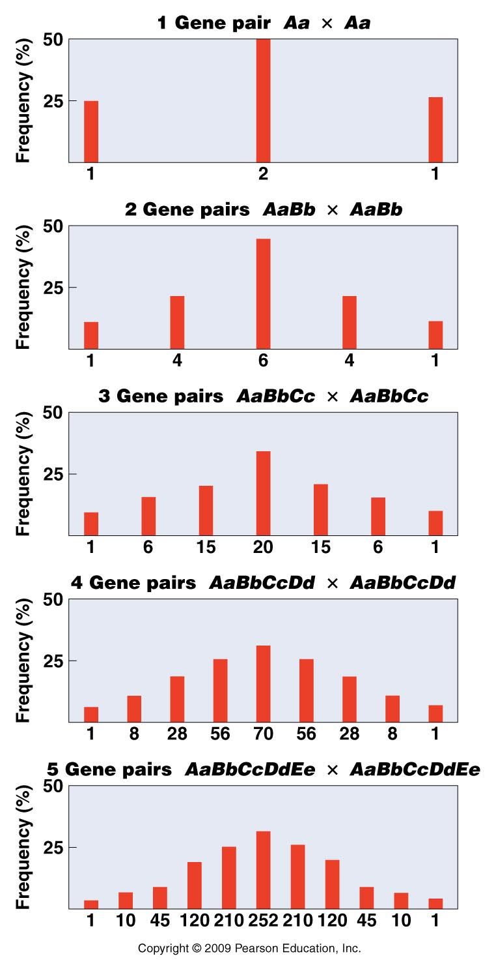
This reminds us of incomplete dominance—exacly the concept!
The number of intermediate forms in a quantitative trait increases with the number of genes involved!
Counting the number of intermediate forms, we see that we get 2n+1 versions of the trait, where n is the number of genes involved.
Figure 25.3
Notes:
Figure 25-3 The results of crossing two heterozygotes when polygenic inheritance is in operation with 1–5 gene pairs. Each histogram bar indicates a distinct F2 phenotypic class from one extreme (left end) to the other extreme (right end). Each phenotype results from a different number of additive alleles.

Slide 13
Clarification:
For quantitative traits we think of the extreme variations---such as deep red wheat and pure white wheat, and intermediate forms.
For a n=2 gene trait there are 2n-1=3 intermediate forms.
For a n=2-gene trait, there are 2n+1=5 total versions of the trait.

Slide 14
3 intermediate/5 total
5 intermediate/7 total
7 intermediate/9 total
9 intermediate/11 total

Slide 15
Continuing with the concept of dosage….
We have already covered the genetic “extension” of sex-linked traits. We spent most of the time thinking about X-linked traits.
Why?
In a sense, the X-chromosome is not a “sex chromosome”. The Y- has male determination genes. Y-determines maleness.

Slide 16
But the X-chromosome has thousands of genes---encoding all types of proteins that are not male or female specific.
But females have 2 copies of each X-linked gene and males have only 1.
Females can make 2X the dose of each X-linked gene compared to males.

Slide 17
Gene dose is important---we have seen cases where an “extra” dose gives a pretty drastically abnormal phenotype.
Example(s)?

Slide 18
To make sure males and females express equal doses of X-linked genes….
Males could have a mechanism to make 2X the X-linked gene products.
Think about central dogma
Females could have a mechanism to make only ½ the X-linked gene products encoded on their 2 X-chromosomes…

Slide 19
X-inactivation…
To make sure that females do not over-express X-linked genes, they make sure each cell expresses only one of the 2 copies. This is called dosage compensation.
X-inactivation was first discovered by just looking at cells in the microscope. A scientist named Murray Barr saw a dark blob in somatic cells of females mammals, not present in somatic cells of males.

Slide 20
Further study confirmed that the blob was a permanently condensed X-chromosome.
Studies of cells from people with different numbers of X-chromosomes showed more than one “Barr body”, which was consistent with inactivation of all but one X-chromosome.

Slide 21
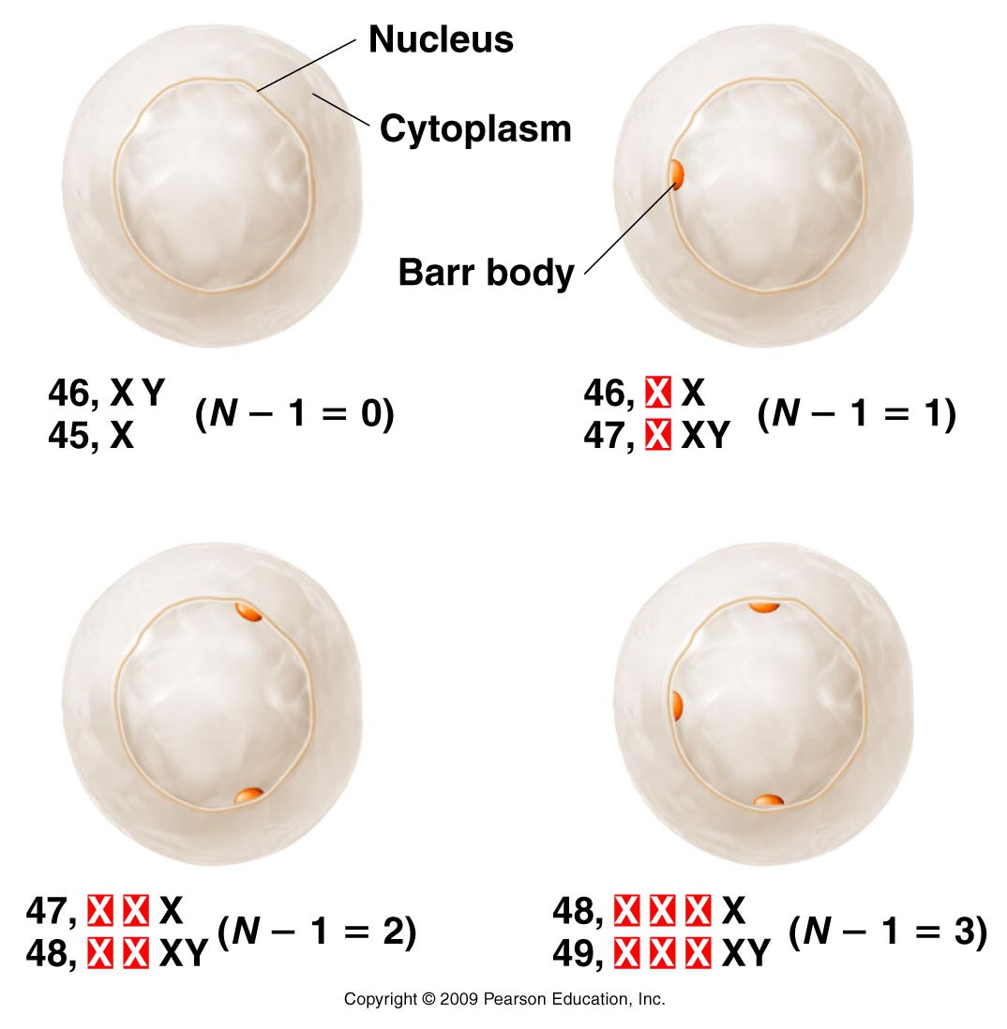
Counting # of Barr bodies…in people with normal and abnormal numbers of sex chromosomes..
Cell from individuals with various numbers of X-chromosomes in activate all but one X…
Figure 7.11
Notes:
21
Figure 7-11 Barr body occurrence in various human karyotypes, where all X chromosomes except one (N –1) are inactivated.

Slide 22
Another scientist, Mary Lyon, proposed that each cell (in females), randomly inactivates one of the 2 X-chromosomes.
The process was named “lyonization” for her.

Slide 23
Random X-inactivation creates unique distribution of cells…
Mary Lyon proposed that X-inactivation occurs early in development and that all cells derived from a specific cell maintain the same inactivated X.
Females become mosaics in terms of active X chromosomes.
This is noticeable in heterozygotes.

Slide 24
What is the result?
Developed organism will have distinct patches of cells derived from cells with different inactivated X-chromosomes.
A scientist, Mary Lyon observed this in female mice, heterozygous for a coat color allele. Get mottled (patches) of color.
We now call this “Lyonization” ☺

Slide 25
See the mottled mouse?

Slide 26
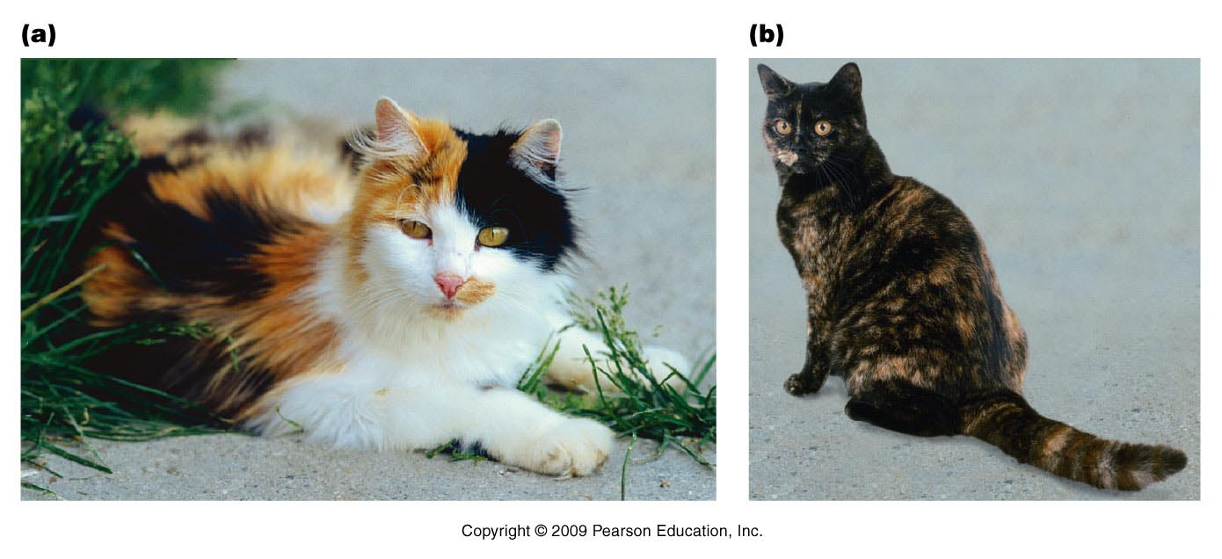
X-inactivation is the molecular explanation of calico and tortoise shell coat patterns in cats.
http://en.wikipedia.org/wiki/X-inactivation
Lyonization
Figure 7.12
Notes:
26
Figure 7-12 (a) A calico cat, where the random distribution of orange and black patches illustrates the Lyon hypothesis. The white patches are due to another gene; (b) A tortoiseshell cat, which lacks the white patches characterizing calicos.

Slide 27
Calico and tortious shell cats are always female, heterozygotes.

Slide 28
Are you wondering…?
Carrier females who have only one copy of the mutant allele do not usually express the recessive phenotype---why? After all, 50% of the time, they should inactivate the dominant allele on one of their X chromosomes and express only the recessive allele.

Slide 29
Because the inactivation is random, ~ 50% of the cells WILL express the wild type, dominant form of the gene which prevents expression of the recessive trait in the whole organism.
Practice thinking of this! Draw this!

Slide 30
Some human phenotypes also reveal random X inactivation.
Example---anhidrotic ectodermal dysplasia
Lack of sweat glands.
Seen in heterozygous females as patches of tissue which have or lack sweat glands.

Slide 31
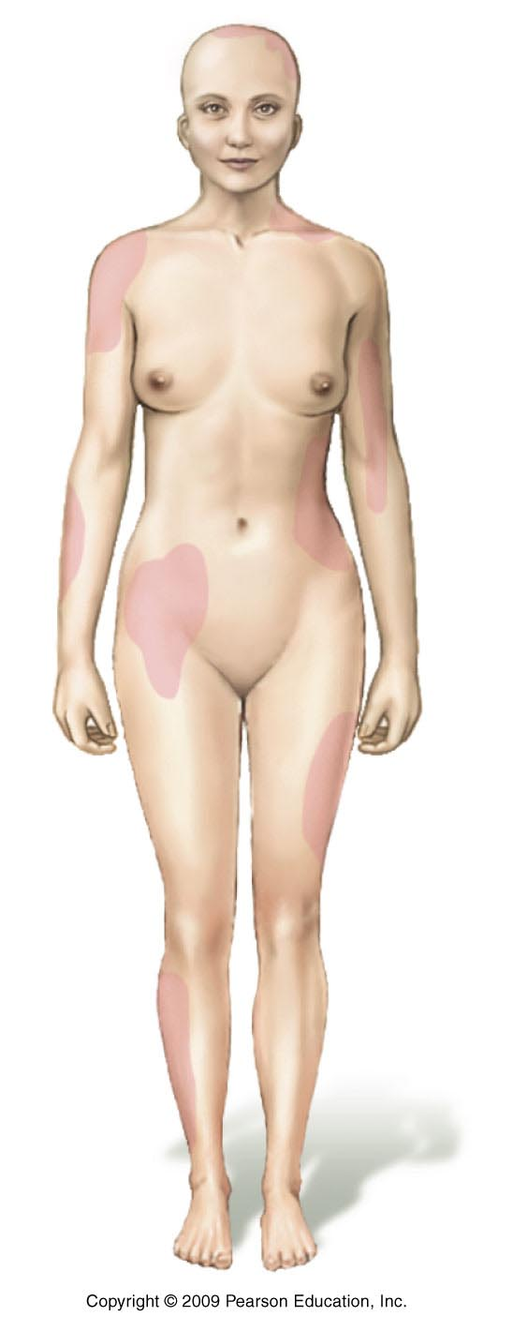
Figure 7.13
Notes:
31
Figure 7-13 Depiction of the absence of sweat glands (shaded regions) in a female heterozygous for the X-linked condition anhidrotic ectodermal dysplasia. The locations vary from female to female, based on the random pattern of X chromosome inactivation during early development, resulting in unique mosaic distributions of sweat glands in heterozygotes.

Slide 32
Read the paper
Mechanism for X-inactivation is very interesting. (section 7.5 and paper on website)
http://www.nature.com/scitable/topicpage/sex-chromosomes-in-mammals-x-inactivation-522

